Slide 1
Activities for this week
Group work
Lectures
R exercise
MONDAY (10 Oct) | TUESDAY (11 Oct) | WEDNESDAY (12 Oct) | THURSDAY (13 Oct) | FRIDAY (14 Oct)
Group work: Exploring geographic distributions of European trees (9:15-12:00) Lecture: Introduction to ranges, distributions, and adaptation (13:15-15:00) | Lecture: The what, how, why of species distribution modeling (9:15-10:00) R exercise: Species occurrences (10:15-12:00) R exercise: Environmental data (13:15-15:00) | R exercise*: Introduction to SDMs (9:15-12:00) *Bob will walk through this exercise in real time | Lecture: Potential and pitfalls of SDMs (9:15-10:00) R exercise: Self-work and help time for R exercises (10:15-12:00) Lecture: Biodiversity in space and time (13:15-15:00) | Lecture: Measuring biodiversity (9:15-10:00) Group work: Measuring biodiversity (10:15-15:00)

Slide 2
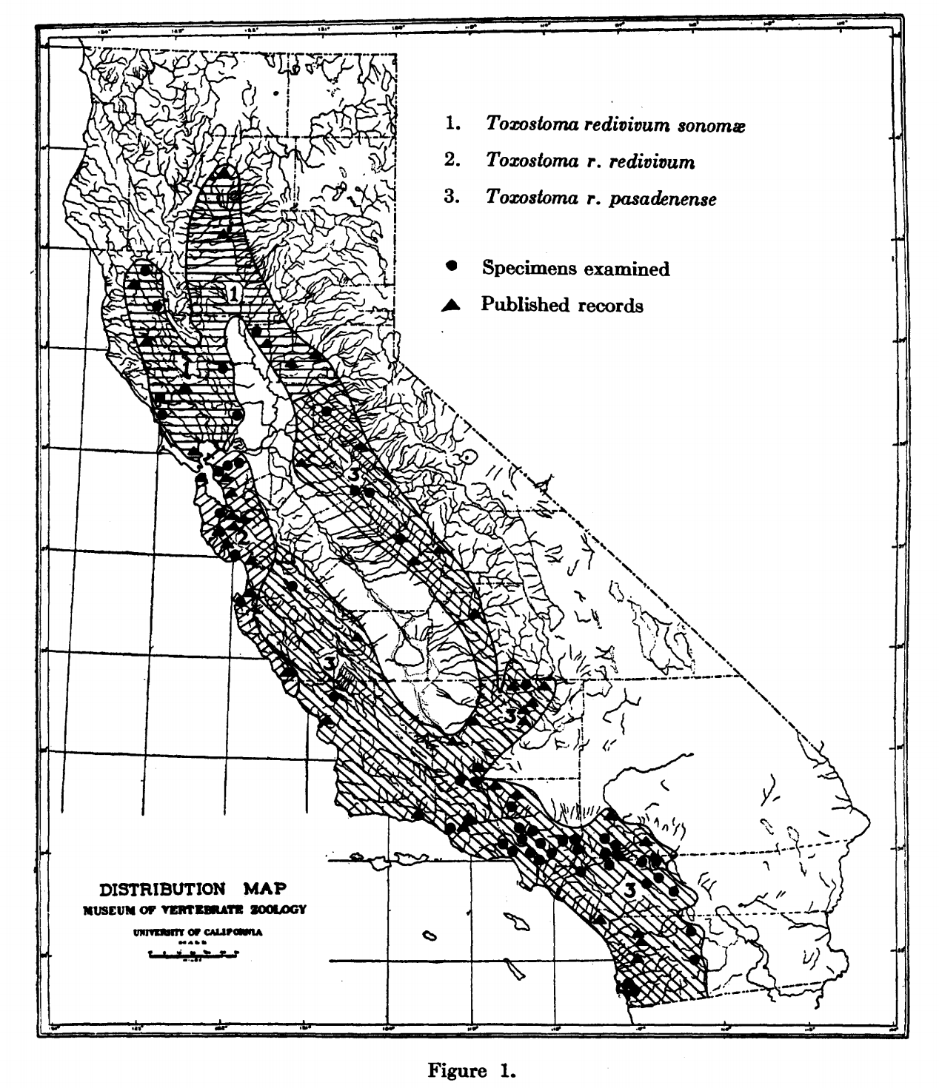
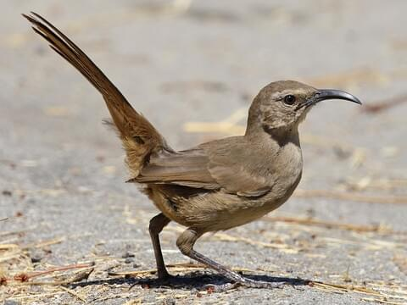
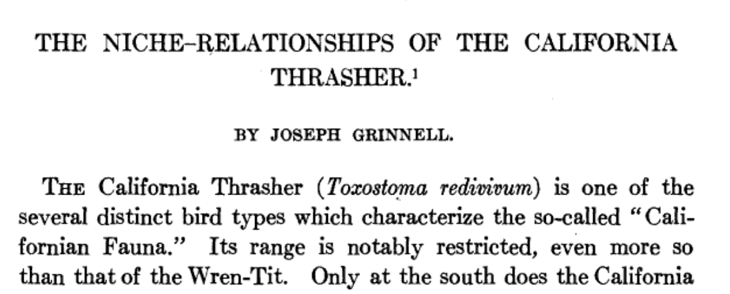
The what, how, why of Species Distribution Models
Bob Muscarella
Grinnell (1917) doi:10.2307/4072271

Slide 3
The what, how, why of SDMs
What:
Models that describe the distribution of species across space or environmental gradients
How:
Develop statistical relationships between environmental conditions and locations where a species is present (and, in some cases, absent)
Why:
Address fundamental questions of ecology / evolution
Understand the potential exposure of species to environmental change
Develop solutions for applied problems in conservation, restoration, agriculture, forestry, etc.

Slide 4
The what, how, why of SDMs/ENMs
What:
Models that describe the distribution of species across space or environmental gradients

Slide 5
The what, how, why of SDMs/ENMs
What:
Models that describe the distribution of species across space or environmental gradients
ENMs (Ecological or Environmental niche models) focus on environmental space
SDMs (Species distribution models) focus on geographic space
Probability of species occurrence
Environment variable 1

Slide 6
The what, how, why of SDMs/ENMs
What:
Models that describe the distribution of species across space or environmental gradients
Environmental and geographic space
G space
E space

Slide 7
The what, how, why of SDMs/ENMs
What:
Models that describe the distribution of species across space or environmental gradients
Environmental and geographic space
E space
Variable 2
G space
Variable 1

Slide 8
“Probability of occurrence”
Occurrences
Geographic distribution
Juniperus communis
Larix decidua

Slide 9
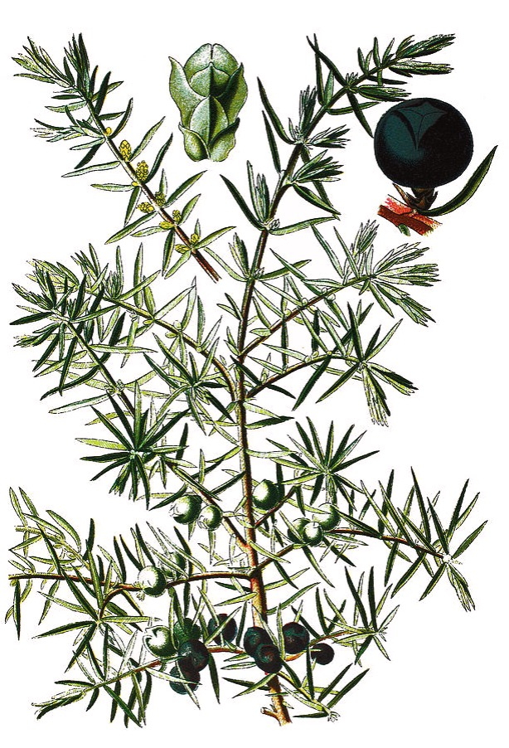
Juniperus communis
Distribution in ‘geographic space’
Distribution in ‘environmental space’
Annual precipitation (mm)
Annual average temperature (˚C)

Slide 10
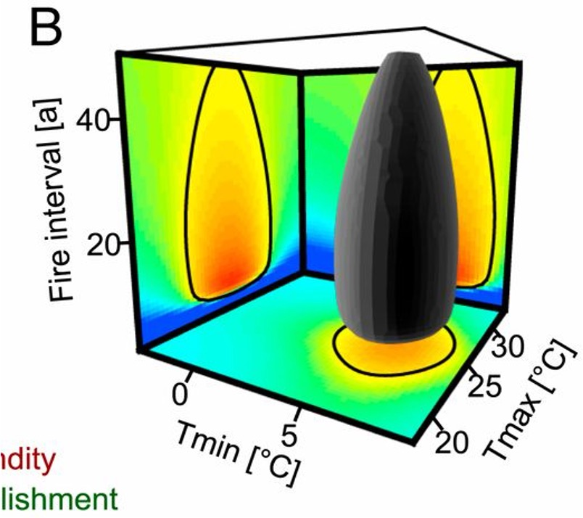
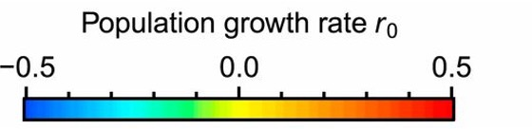
The what, how, why of SDMs/ENMs
What:
Models that describe the distribution of species across space or environmental gradients
Environmental and geographic space
Link environment and fitness
Pagel et al. (2020) Proc. of the National Academy of Sciences. https://www.pnas.org/content/117/7/3663

Slide 11
The what, how, why of SDMs/ENMs
What:
Models that describe the distribution of species across space or environmental gradients
How:
Develop statistical relationships between environmental conditions and locations where a species is present (and, in some cases, absent)

Slide 12
The what, how, why of SDMs/ENMs
What:
Models that describe the distribution of species across space or environmental gradients
How:
Develop statistical relationships between environmental conditions and locations where a species is present (and, in some cases, absent)
Correlative vs. Mechanistic
Correlative SDMs are based on statistical relationships between locations where a species occurs and environmental conditions.
Mechanistic SDMs are based on physiological and/or demographic processes that underly the response of a species to environmental conditions.

Slide 13
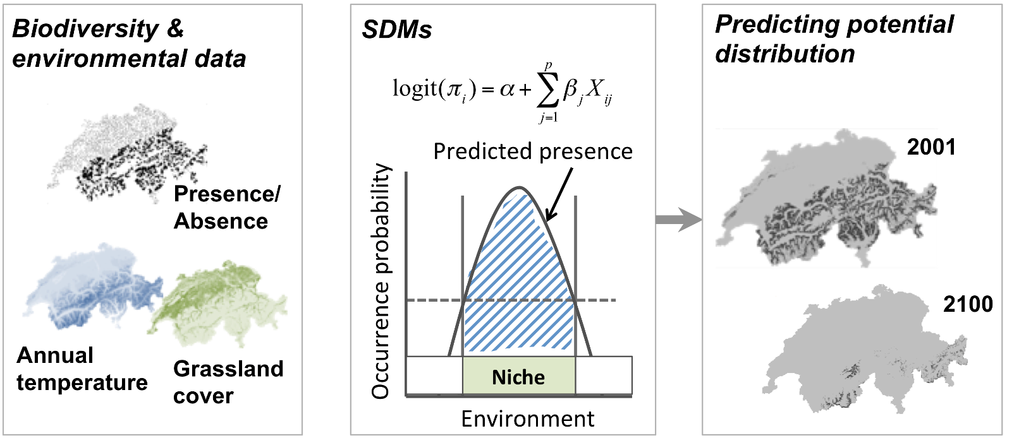
Correlative SDMs/ENMs
https://damariszurell.github.io/SDM-Intro/

Slide 14
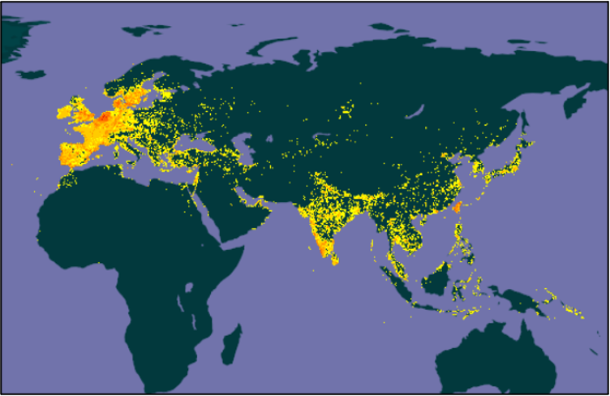
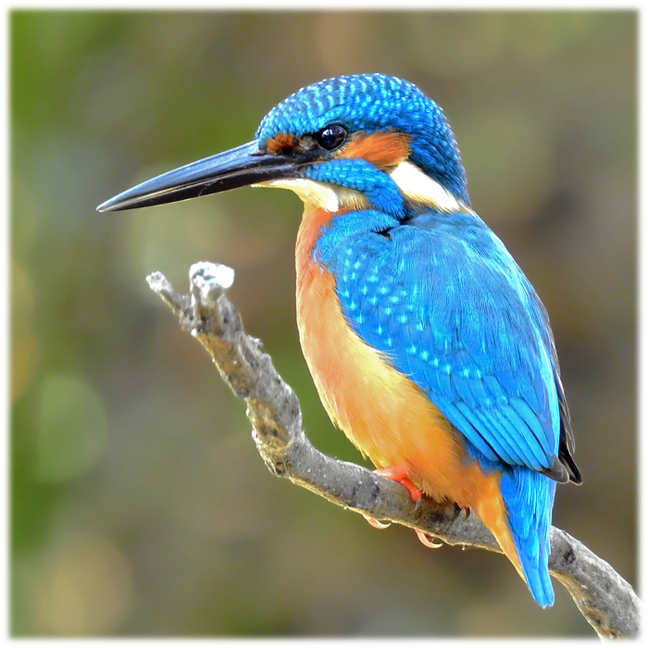
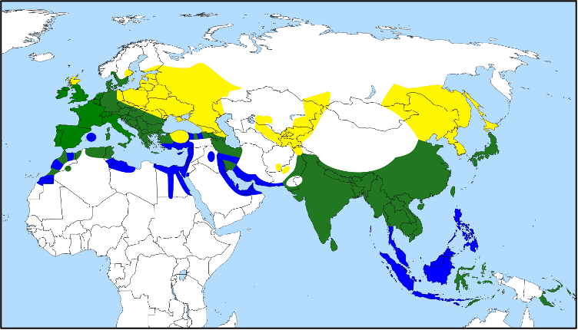
Who is where?
Common kingfisher (Alcedo atthis)
Occurrence observations
(e.g., https://www.gbif.org/)
Range map
Breeding range
Resident all year-round
Non-breeding range
Photo: Shantanu Kuveskar

Slide 15
Who is where?
Species observations
Checklists
Other studies
Herbarium collections
Other biological collections
Citizen science
Species occurrence records
Dataset | Link
ArtPortalen (Sweden) | https://www.artportalen.se/
Biodiversity Information Serving Our Nation (BISON) | https://bison.usgs.gov/
BioTime | http://biotime.st-andrews.ac.uk/home.php
Botanical Information and Ecology Network (BIEN) | http://bien.nceas.ucsb.edu/bien/
eBird | https://ebird.org/home
ForestGEO | https://forestgeo.si.edu/
ForestPlots.net | https://www.forestplots.net/
Global Biodiversity Information Facility (GBIF) | https://www.gbif.org/
iNaturalist | https://www.inaturalist.org/
International Union for the Conservation of Nature (IUCN) Redlist | http://www.iucnredlist.org/
Neotoma | https://www.neotomadb.org/
Paleobiology Database | https://paleobiodb.org/#/
PalmTraits | https://datadryad.org/stash/dataset/doi:10.5061/dryad.ts45225
Phylacine | https://datadryad.org/stash/dataset/doi:10.5061/dryad.bp26v20
USGS Breeding Bird Survey | http://www.pwrc.usgs.gov/BBS/
VertNet | http://vertnet.org/

Slide 16
Who is where?
Occurrence records are biased / incomplete samples in terms of taxonomy, geography, and time
Taxonomic Coverage
Geographic Coverage
Meyer et al. (2016) Multidimensional biases, gaps and uncertainties in global plant occurrence information. Ecology Letters, 19: 992-1006. doi:10.1111/ele.12624

Slide 17
Environmental data
Mean Annual Precipitation
Human Footprint Index
Elevation
Tree height
Notes:
It is a fascinating time to be an ecologist. Literally at our fingertips we have access to huge amounts of data, at large spatial scales, that describe everything from climate, topography, human influence, forest height, and that is just the tip of the iceberg.
COMMUNITY ECOLOGY HAS A LOT TO OFFER MACROECOLOGY
...

Slide 18
Hurricane tracks since 1851
Notes:
The first comes from the Caribbean basin, where I’ve done a lot my work and where hurricanes are a major and persistent disturbance. This map shows trajectories of every hurricane during the past 150 years.

Slide 19
Environmental data
What is the biological process I am trying to understand?
What environmental conditions might affect this process?
What is spatial / temporal scale is relevant for my question?
Notes:
Earlier this year, I led the ground-based component of a major campaign to collect a variety of high resolution remote sensing data across the island. The overarching goal of this program is better parameterize the tropical components of earth systems models but the variety of data that are becoming available open a huge number of potential research directions.

Slide 20
The what, how, why of SDMs/ENMs
What:
Models that describe the distribution of species across space or environmental gradients
How:
Develop statistical relationships between environmental conditions and locations where a species is present (and, in some cases, absent)
Correlative vs. Mechanistic
Correlative SDMs are based on statistical relationships between locations where a species occurs and environmental conditions.
Mechanistic SDMs are based on physiological and/or demographic processes that underly the response of a species to environmental conditions.

Slide 21

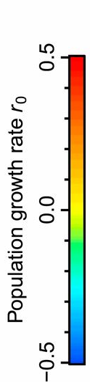
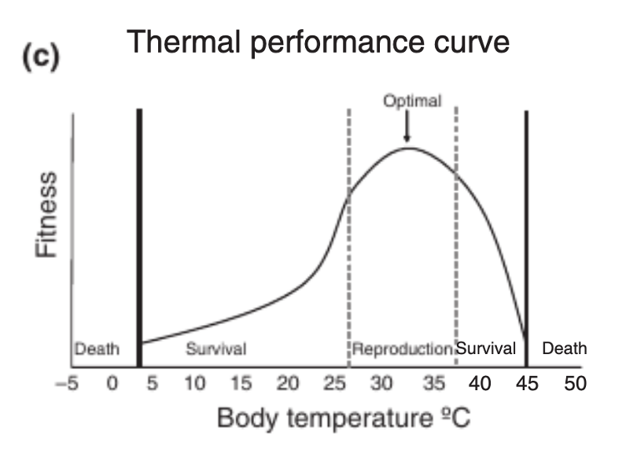
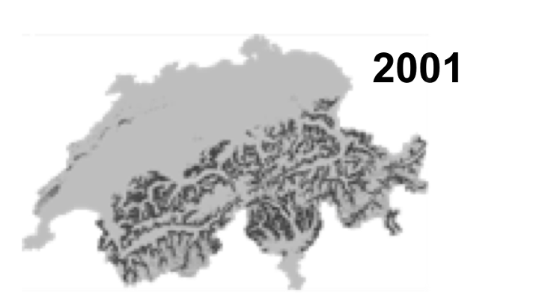
Mechanistic SDMs/ENMs
Fitness
Body temperature ˚C
Kearney and Porter (2009) Ecology letters 12 4: 334-50.

Slide 22
The what, how, why of SDMs/ENMs
What:
Models that describe the distribution of species across space or environmental gradients
How:
Develop statistical relationships between environmental conditions and locations where a species is present (and, in some cases, absent)
Correlative vs. Mechanistic
Presence-absence vs. presence-only
Presence-absence models models explicitly include information where a species known (or at least believed) to be absent.

Slide 23
Presence-absence models
Present
?
Absent
Probability
of species occurrence
Environment variable 1

Slide 24
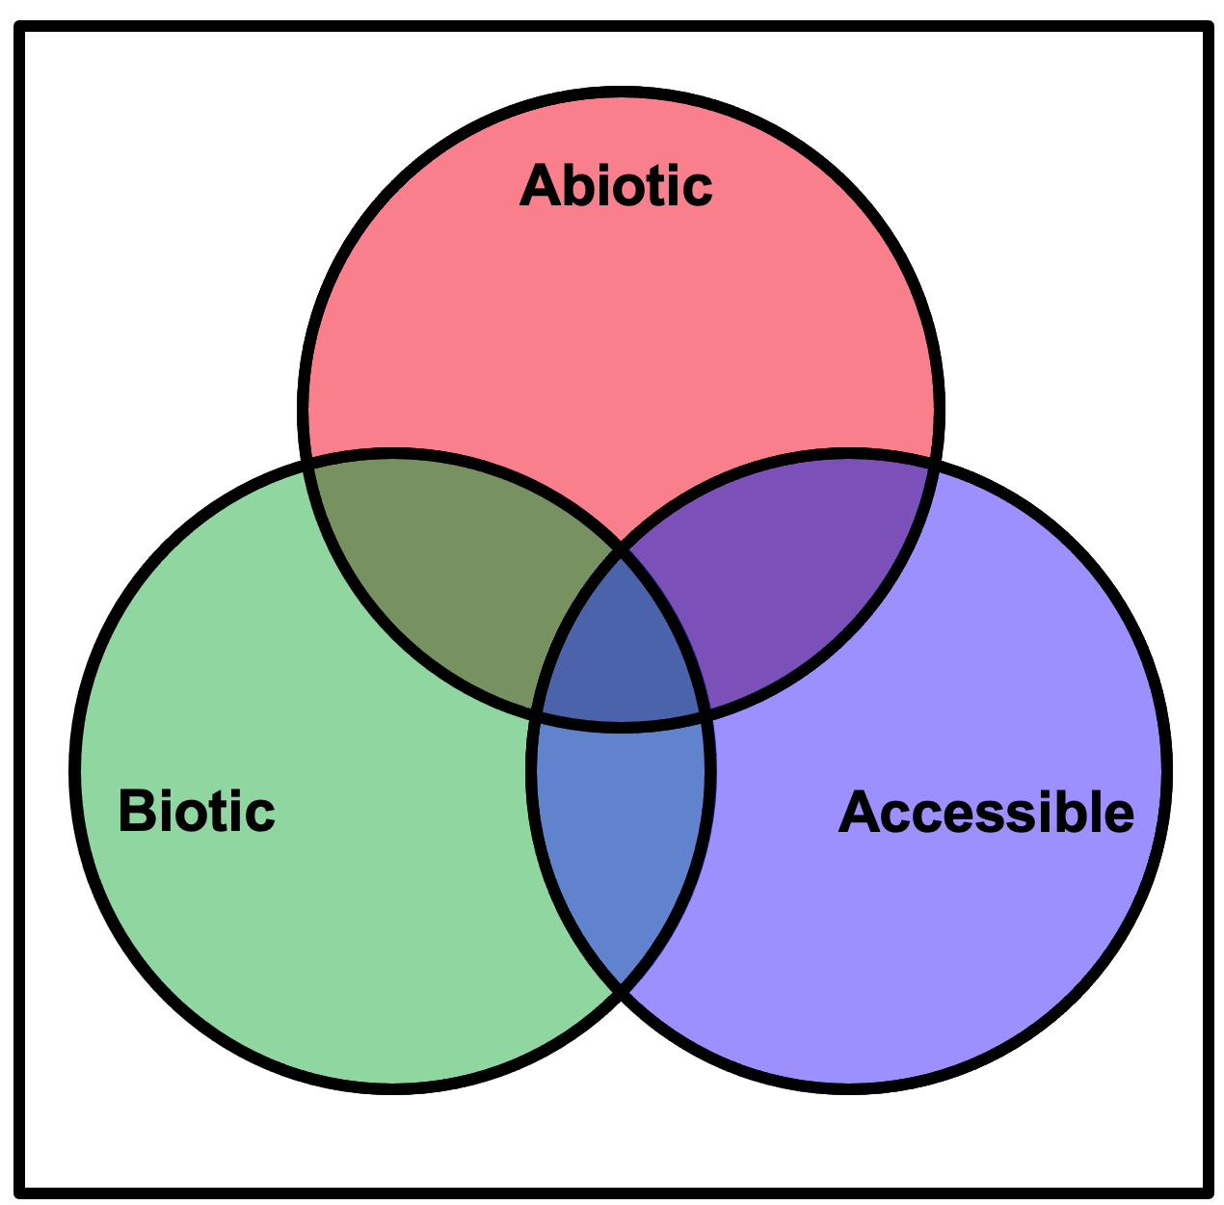

Presence-absence models
The challenge of true absences…
Are the abiotic conditions such that the species cannot survive?
Are there biotic interactions that limit its presence?
Has it had opportunity to arrive in the place?
Am I looking for it at the right time of day / year?
Is it difficult (for me) to detect / identify?
Does it move?

Slide 25
Presence-absence models
High quality absence data is much less common than presence data.

Slide 26
The what, how, why of SDMs/ENMs
What:
Models that describe the distribution of species across space or environmental gradients
How:
Develop statistical relationships between environmental conditions and locations where a species is present (and, in some cases, absent)
Correlative vs. Mechanistic
Presence-absence vs. presence-only
Presence-absence models models explicitly include information where a species known (or at least believed) to be absent.
Presence-only models are based only on data where a species is known to be present and the landscape of interest.

Slide 27
Presence-absence models
Present
?
Background (Pseudo-absence)
Relative occurrence rate
Environment variable 1

Slide 28
The what, how, why of SDMs/ENMs
What:
Models that describe the distribution of species across space or environmental gradients
How:
Develop statistical relationships between environmental conditions and locations where a species is present (and, in some cases, absent)

Slide 29
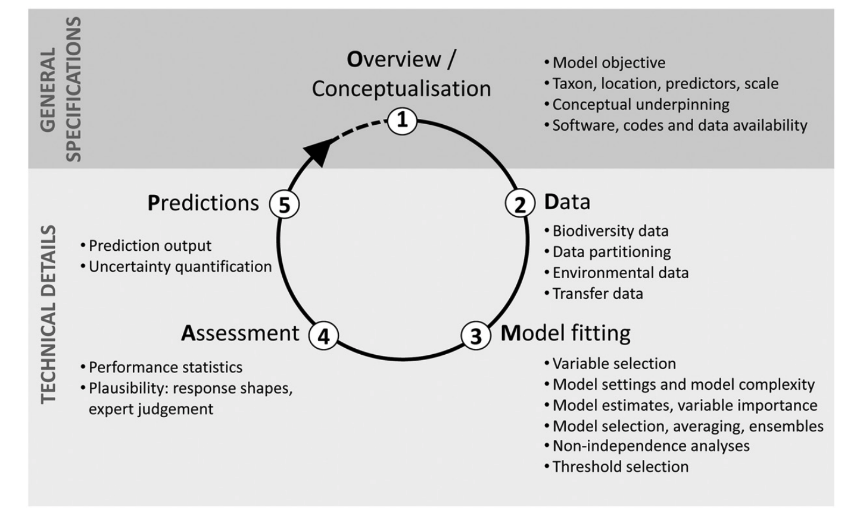
SDM / ENM workflow
Zurell et al. (2020) A standard protocol for reporting species distribution models. Ecography, 43, 1261-1277.

Slide 30
The what, how, why of SDMs/ENMs
What:
Models that describe the distribution of species across spatial or environmental gradients
How:
Develop statistical relationships between environmental conditions and locations where a species is present (and, in some cases, absent)
Why:
Understanding distribution of species is fundamental to ecology / evolution
Develop solutions for applied problems in conservation, restoration, agriculture, forestry, etc.
Forecast exposure of species to environmental change
Understand the consequences of ecosystem services under climate change
Predict the spread and impact of invasive species
These models are very widely used and (for better or worse) inform conservation, management, and policy

Slide 31
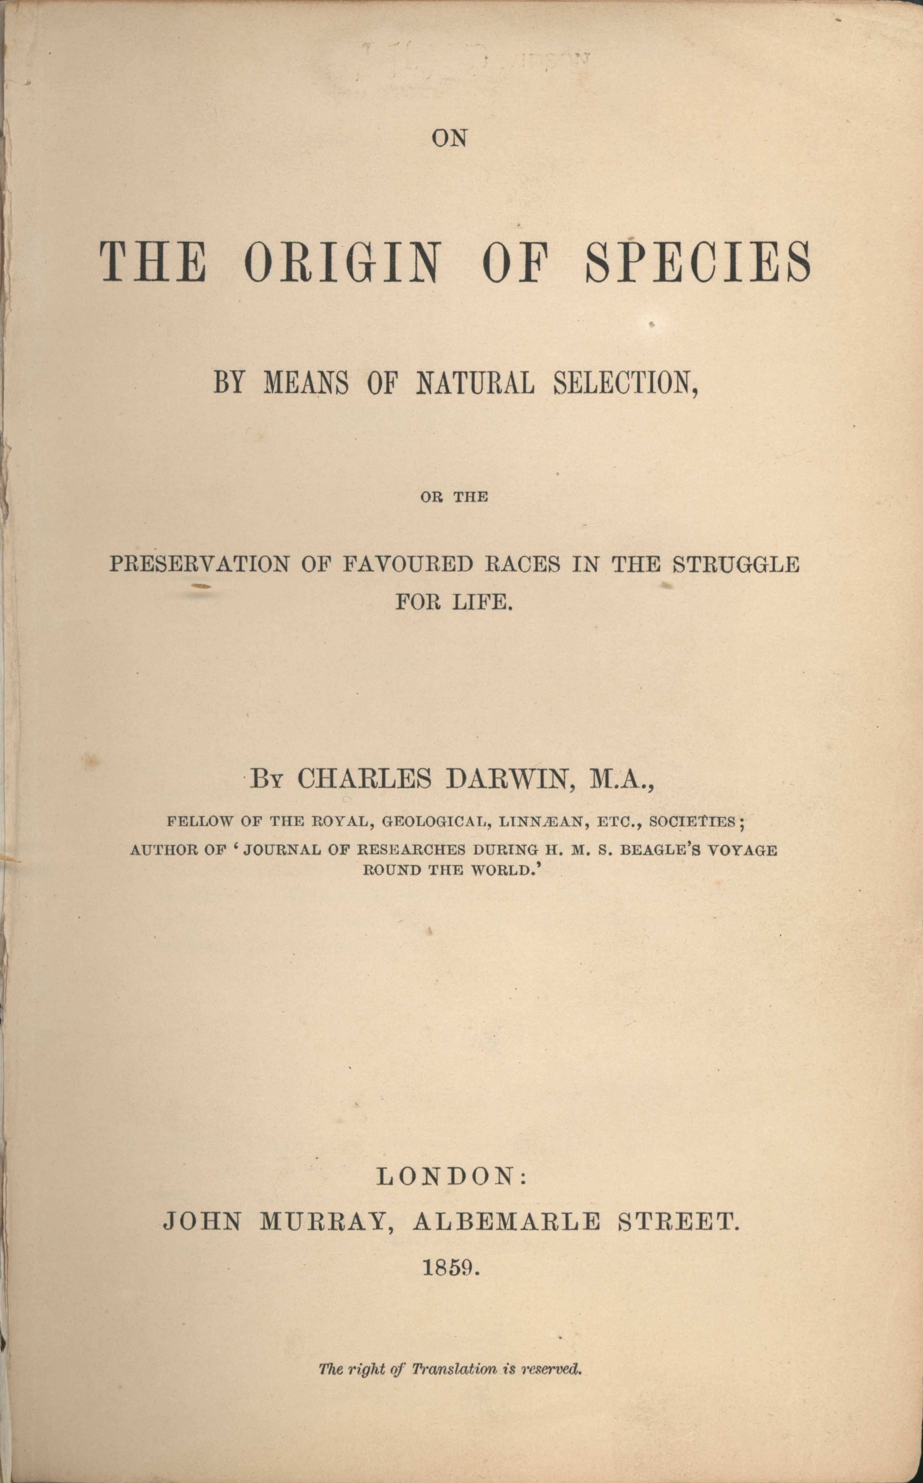
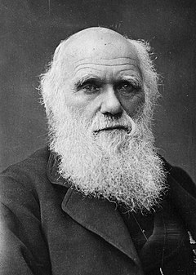

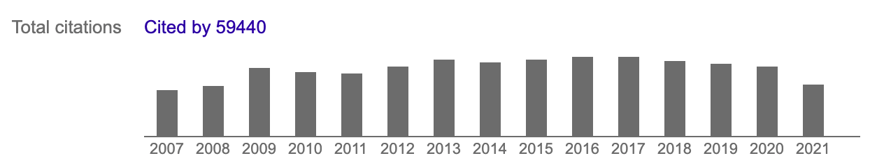
Published in 1859
2742

Slide 32
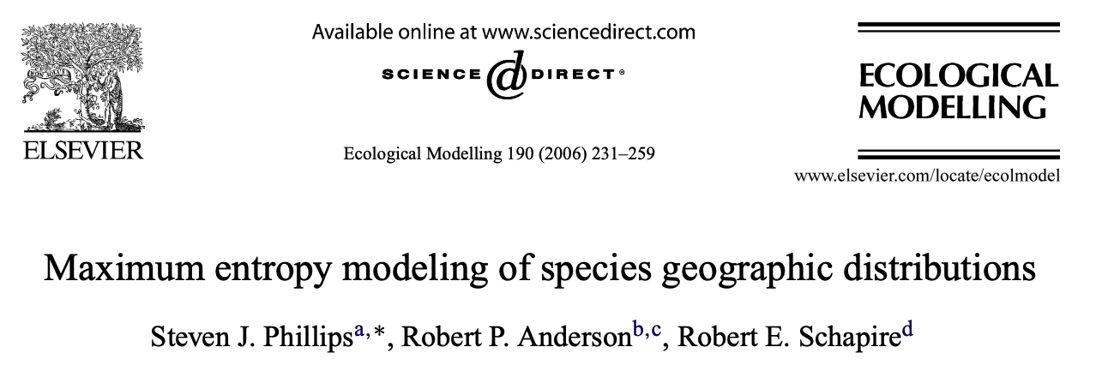
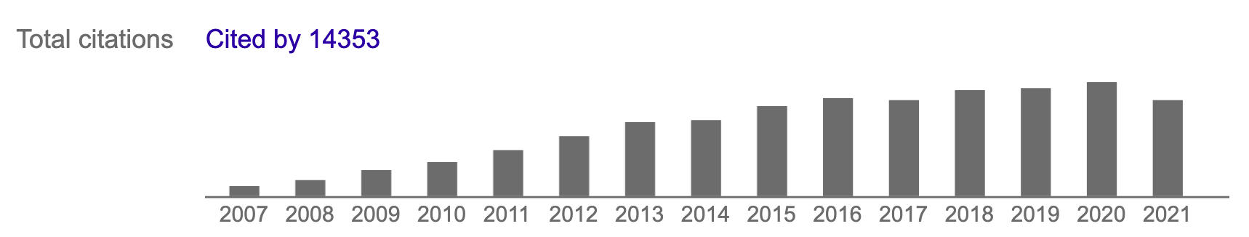
Published in 2006
1533

Slide 33
After 15 years, a major paper on SDMs has ~25% as many citations as Darwin’s
“The Origin of Species”

Slide 34
Activities for this week
Group work
Lectures
R exercise
MONDAY (10 Oct) | TUESDAY (11 Oct) | WEDNESDAY (12 Oct) | THURSDAY (13 Oct) | FRIDAY (13 Oct)
Group work: Exploring geographic distributions of European trees (9:15-12:00) Lecture: Introduction to ranges, distributions, and adaptation (13:15-15:00) | Lecture: The what, how, why of species distribution modeling (9:15-10:00) R exercise: Species occurrences (10:15-12:00) R exercise: Environmental data (13:15-15:00) | R exercise*: Introduction to SDMs (9:15-12:00) *Bob will walk through this exercise in real time | Lecture: Potential and pitfalls of SDMs (9:15-10:00) R exercise: Self-work and help time for R exercises (10:15-12:00) Lecture: Biodiversity in space and time (13:15-15:00) | Lecture: Measuring biodiversity (9:15-10:00) Group work: Measuring biodiversity (10:15-15:00)

